Slide 1
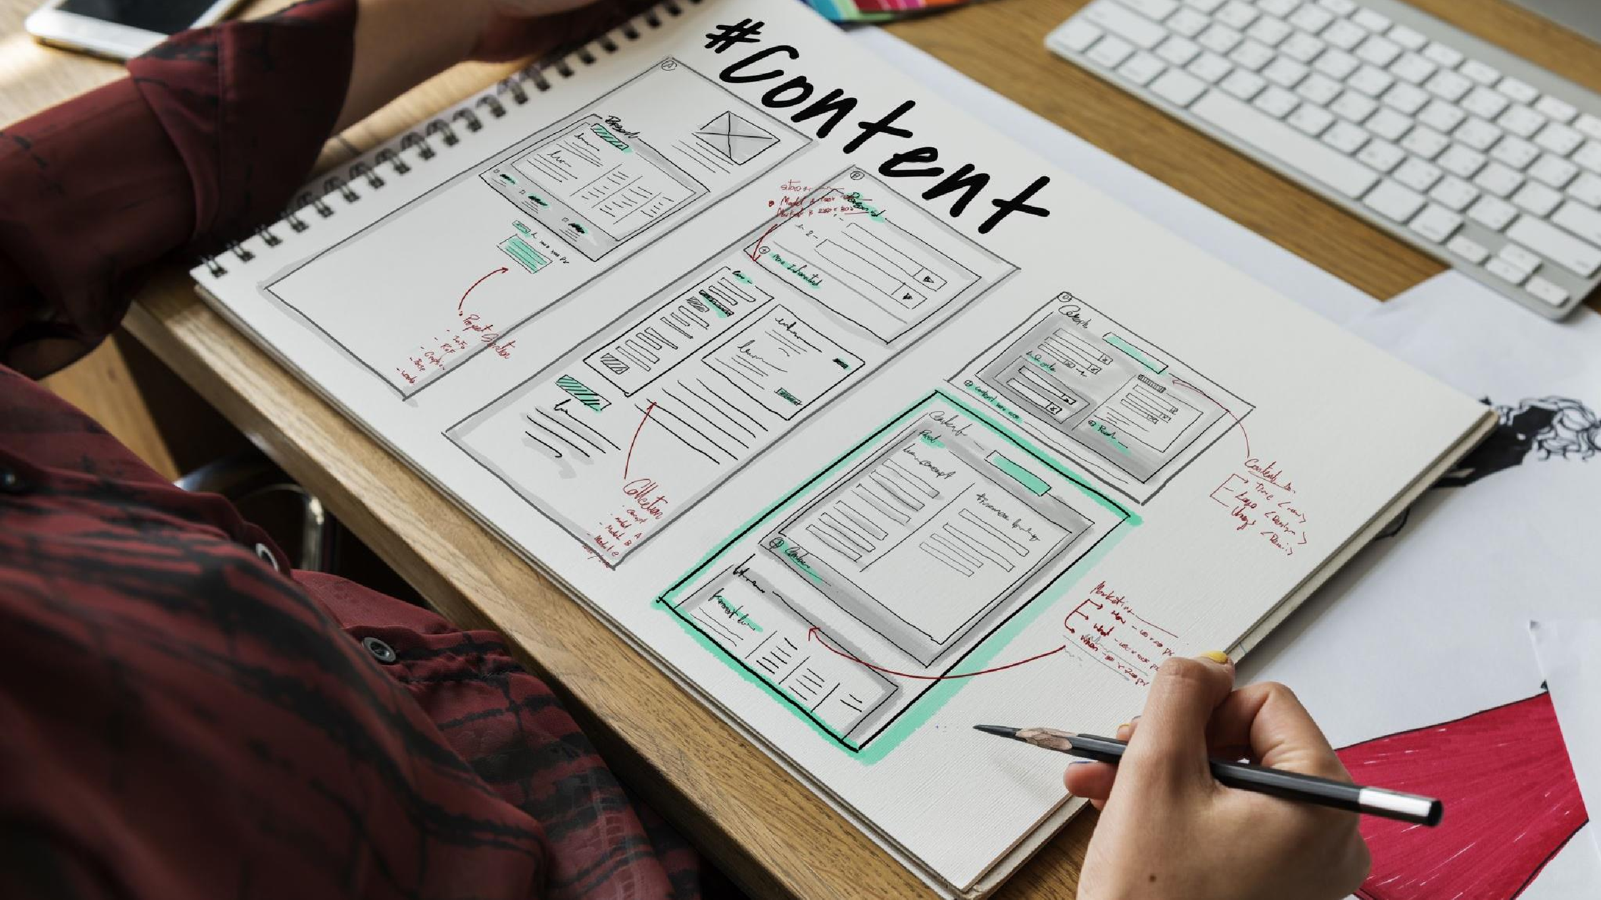

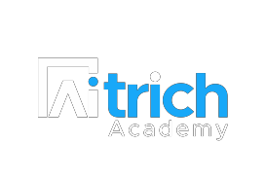
Agile Requirements Engineering
Embracing Collaboration, Adaptability,
and Customer Satisfaction

Slide 2


Revisiting Agile
Definition of Agile:
Iterative and flexible approach to software development
Emphasizes collaboration, adaptability, and customer satisfaction
Key principles of Agile:
Customer collaboration and responsiveness to change
Delivering working software and promoting self-organizing teams
Valuing individuals, interactions, and
continuous improvement
Benefits of Agile:
Improved customer satisfaction
Increased adaptability to changing requirements
Faster time-to-market
Enhanced teamwork and collaboration
Higher product quality

Slide 3

Agile Requirements Engineering Overview
Definition of Requirements Engineering:
Process of eliciting, documenting, validating, and managing requirements for a software project
Challenges in traditional requirements
gathering:
Incomplete or changing requirements
Difficulty in capturing user needs effectively
Limited collaboration and feedback
opportunities
Agile Requirements Engineering approach:
Adaptive and collaborative approach to address traditional challenges
Emphasizes iterative and incremental
development
Focuses on continuous feedback and collaboration with stakeholders

Slide 4

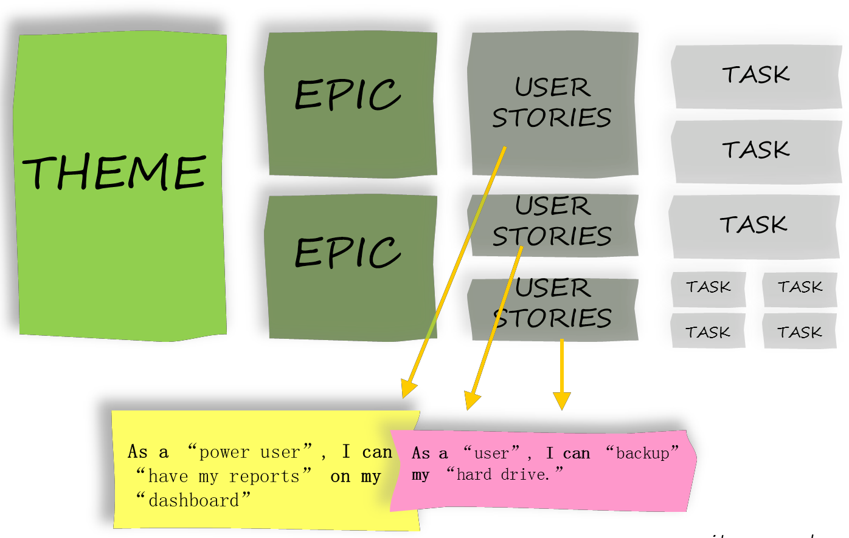
Agile Requirements Engineering Process
User Stories
Epics and Themes
Backlog Refinement
Prioritization Techniques
UI/UX Designing

Slide 5
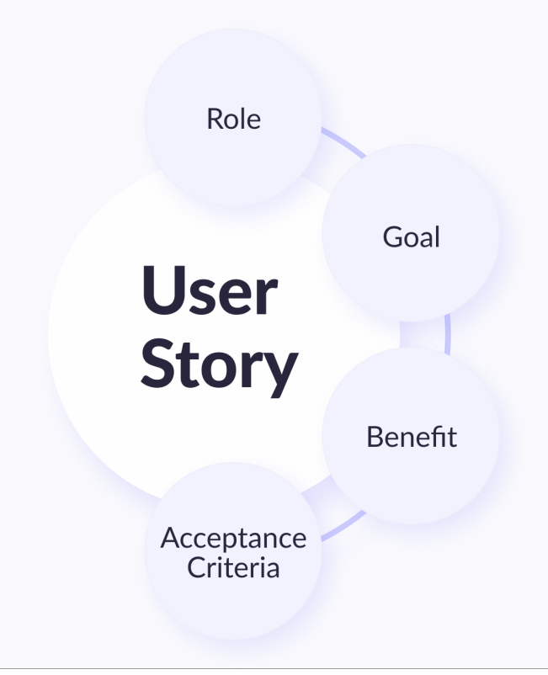


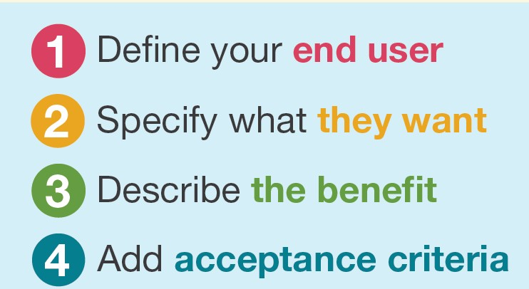
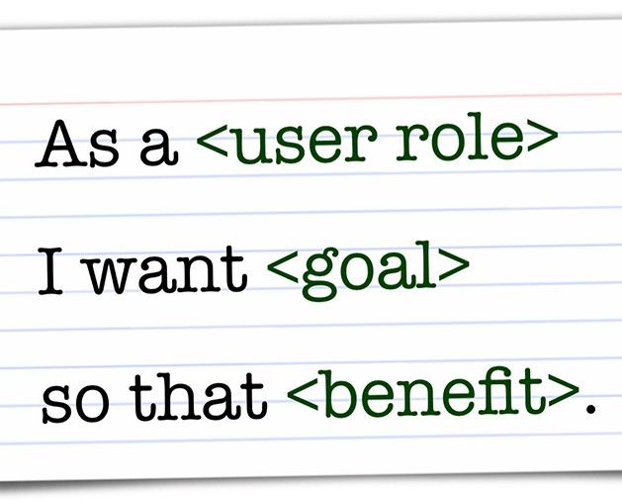
User Stories
Definition of User Stories:
Short, concise descriptions of a feature or functionality from the user's perspective

Slide 6
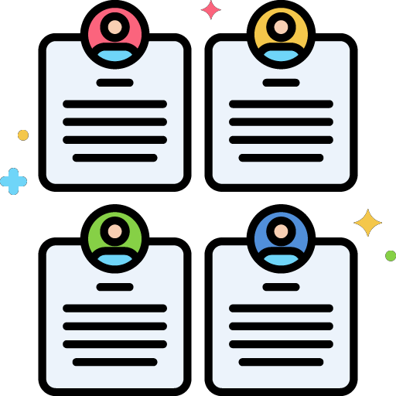
User Stories
Examples
Example 1:
As a job seeker, I want to search and filter
job listings based on my preferences so that
I can find relevant job opportunities
efficiently.
Example 2:
As a job provider, I want to post job listings with detailed descriptions so that I can attract qualified candidates and ensure they have a clear understanding of the job requirements.

Slide 7
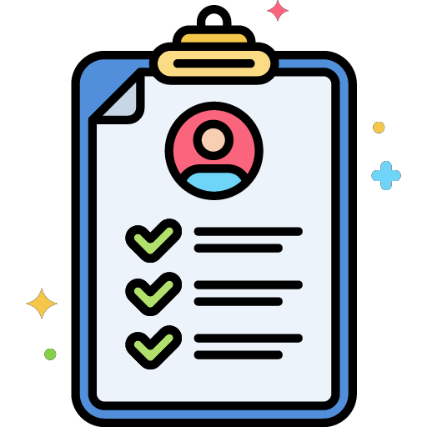
INVEST Criteria
Independent: User stories should be self-
contained and not dependent on other stories.
Set of guidelines used to evaluate
and write effective user stories in Agile development
Negotiable: User stories are flexible and open to discussion and refinement.
Valuable: User stories deliver value to the user or customer.
Estimable: User stories can be estimated in terms of effort or complexity.
Small: User stories are small enough to be completed within an iteration.
Testable: User stories can be validated and tested to ensure successful implementation.

Slide 8
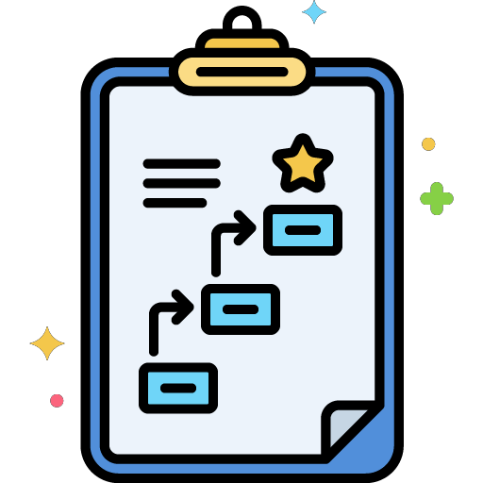
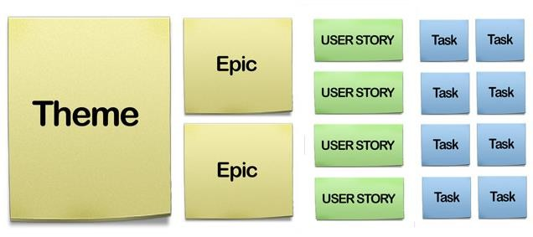
Epics and Themes
Definitions:
Epics: Large user stories that can be broken down into smaller,
more manageable user stories.
Themes: Clusters of related epics that provide a high-level view of the project.
Differentiating Epics and User Stories:
Epics represent broader functionalities or features that may span
multiple iterations.
User stories are smaller, more granular requirements that can be completed within a single iteration.
Examples of Epics and Themes for a Job Portal:
Epic: "As an employer, I want to post job listings with detailed
descriptions."
Theme: "Enhancing Job Search and Filtering Functionality for Job Seekers."

Slide 9
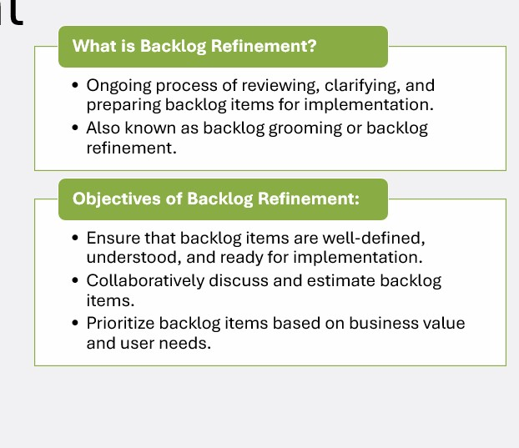
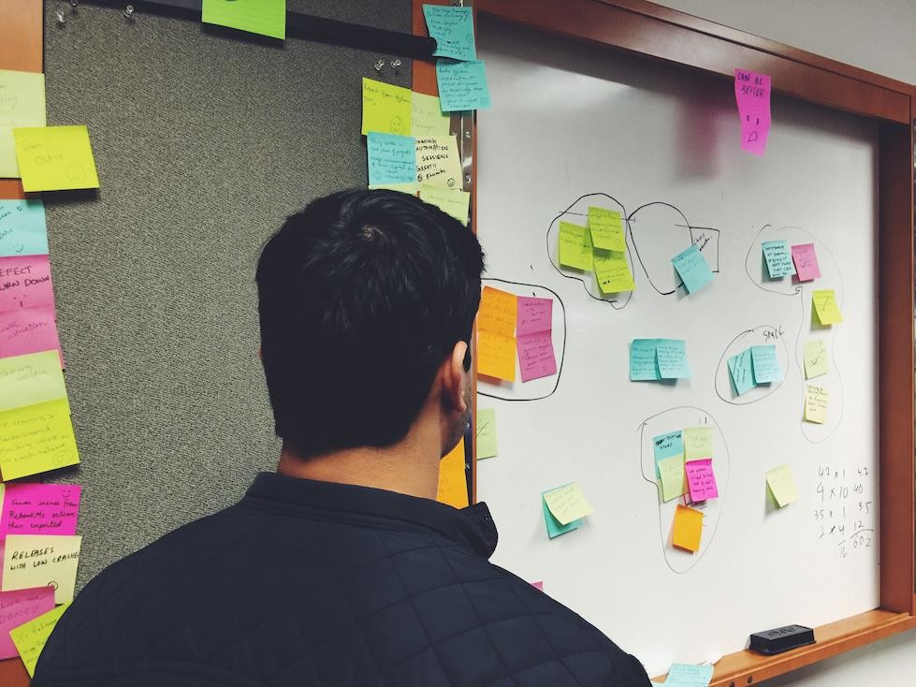
Backlog Refineme
nt

Slide 10
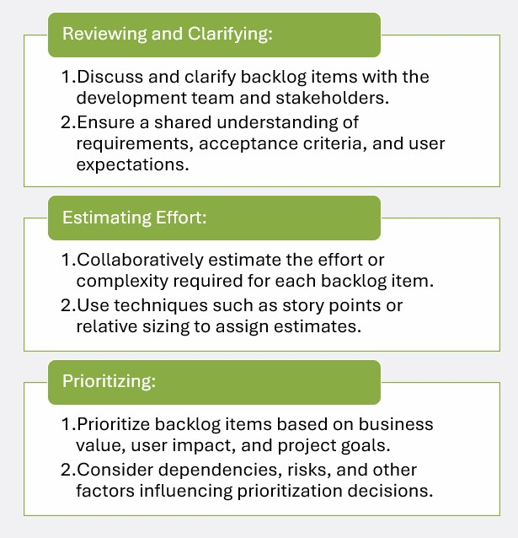

Backlog Refinement:
Activities Involved

Slide 11
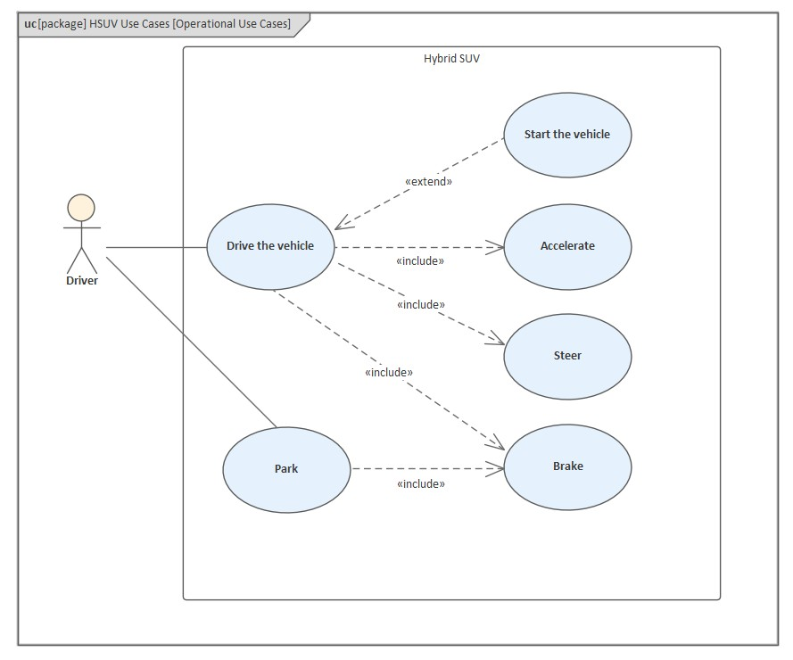
Use Case Diagrams
Definition of Use Case Diagrams:
Use case diagrams depict interactions between actors (users) and the system.
They illustrate the functionality and behavior of the system from a user's perspective.
Elements of Use Case Diagrams:
Actors: Represent individuals, roles, or external
systems interacting with the system.
Use Cases: Represent specific functionalities or actions that the system performs.
Relationships: Show the associations and interactions between actors and use cases.
Benefits of Use Case Diagrams for Requirement
Analysis:
Visual representation of requirements and system behavior.
Facilitate communication and understanding between stakeholders.
Identify system boundaries and external
dependencies.

Slide 12

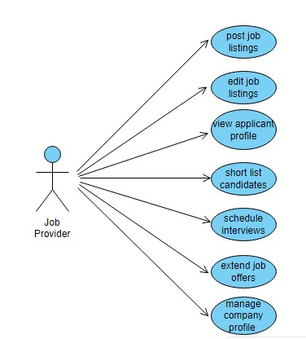
Creating Use Case Diagrams for the Job Portal
Identify actors and their roles:
Job Seekers, Employers, Administrators, and External Systems.
Define use cases and their relationships:
Use cases: Searching for jobs, Applying for jobs, Posting job
listings, Managing user profiles, etc.
Relationships: Association, Include, and Extend relationships between actors and use cases.
Include system boundaries and external systems:
Specify system boundaries to define the scope of the job portal.
Identify any external systems interacting with the job portal, such as payment gateways or authentication providers.

Slide 13

UI/UX Designing
Why UI/UX Designing in Agile
Requirements Engineering:
UI/UX Designing focuses on creating intuitive, user-friendly, and visually appealing interfaces.
Enhances user satisfaction, engagement, and overall user experience.
Collaborative Design Process:
Involves close collaboration between designers, developers, and stakeholders.
Iterative design cycles to gather feedback and refine the interface.

Slide 14
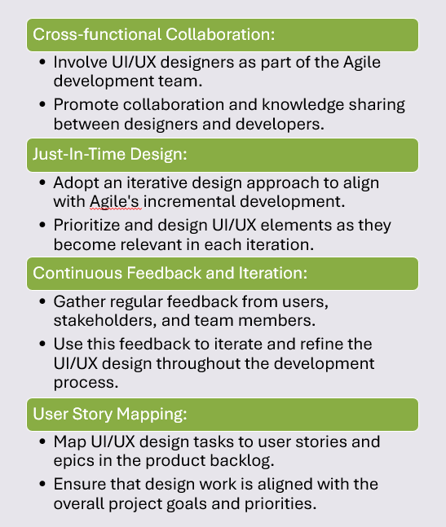

Integrating UI/UX Design in Agile Requirements Engineering

Slide 15
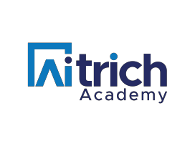
Software Requirements Specification (SRS)
What is an Agile SRS?
A living document that describes the functional and non-functional requirements of the software system.
Serves as a blueprint for the development team and a reference for stakeholders.
Evolves and iterates throughout the Agile
development process.

Slide 16
Introduction:
Purpose, scope, and objectives of the Agile SRS.
Overview of the job portal and its intended users.
Structure of
Agile SRS
System Users/Actors:
Identifying and defining the different roles or actors interacting with the system.
Examples: Job Seekers, Employers, Administrators.
Use Case Diagrams:
Visual representation of system behavior and user interactions.
Illustrates the functionality and relationships between actors and use cases.
User Stories and Epics:
Detailed descriptions of user needs and system features.
Prioritized backlog items based on business value and user impact.
Non-Functional Requirements:
Performance, security, usability, and other quality attributes of the system.
System Constraints:
Technical, operational, and environmental constraints.
Glossary:
Definitions of domain-specific terms and acronyms used in the SRS.
Appendices:
Supporting documentation, diagrams, and additional details.

Slide 17

Conclusion
A Recap
Agile Requirements Engineering emphasizes collaboration, iterative development, and continuous improvement.
Agile techniques such as user stories, epics, and backlog
refinement drive the development process.
Use Case Diagrams and the Software Requirements Specification (SRS) capture system behavior and requirements.
Integrating UI/UX Design enhances user satisfaction and overall user experience.
Remarks
Agile Requirements Engineering empowers teams to deliver high-quality software that meets user needs.
By embracing Agile principles and practices, organizations can foster innovation, efficiency, and customer satisfaction.

